Slide 1
Unit 3 Lecture 11

Slide 2
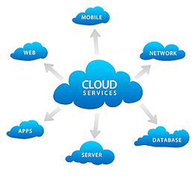
Cloud System
A cloud system or cloud computing technology refers to the computing components (hardware, software and infrastructure) that enable the delivery of cloud computing services such as:
SaaS (software as a service)
PaaS (platform as a service) and
IaaS (infrastructure as service) via a network (i.e. the Internet).

Slide 3
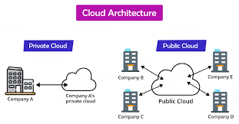
Cloud Architecture

Slide 4
Cloud Computing
Cloud computing is the on-demand availability of computer system resources, especially data storage and computing power, without direct active management by the user.
Large clouds often have functions distributed over multiple locations, each location being a data center
Eg. Include dropbox, Facebook, Gmail.
Cloud can be used for storage of files ,Banking, Financial Services, big data.

Slide 5
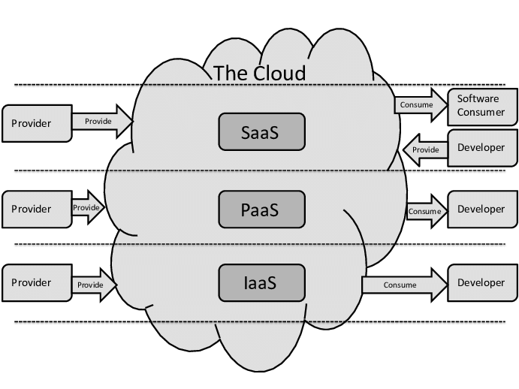
Cloud Computing Architecture

Slide 6
Software as a Service (SaaS):
SaaS architecture providers deliver and maintain applications and software to organizations over the Internet, thereby eliminating the need for end users to deploy the software locally.
SaaS applications are typically accessed via a web interface available from a broad variety of devices .

Slide 7
2. Platform as a Service (PaaS):
In this cloud model, the service provider offers a computing platform and solution stack, often including middleware, as a service.
Organizations can build upon that platform to create an application or service.
The cloud service provider delivers the networks, servers and storage required to host an application while the end user oversees software deployment and configuration settings

Slide 8
3.Infrastructure as a Service (IaaS):
In this, cloud at its simplest form, a third-party provider eliminates the need for organizations to purchase servers, networks or storage devices by providing the necessary infrastructure.
In turn, organizations manage their software and applications, and only pay for the capacity they need at any given time.

Slide 9
Why adopt cloud architecture?
Accelerate the delivery of new apps to modernize applications and accelerate digital transformation.
Ensure compliance with the latest regulations
Deliver greater transparency into resources to cut costs and prevent data breaches
Enable faster provisioning of resources
Utilize hybrid cloud architecture to support real-time scalability for applications as business needs change
Meet service targets consistently
Leverage cloud reference architecture to gain insight into IT spending patterns and cloud utilization

Slide 10
Cloud computing infrastructure
It is the collection of hardware and software elements needed to enable cloud computing.
It includes computing power, networking, and storage, as well as an interface for users to access their virtualized resources.
The virtual resources mirror a physical infrastructure, with components like servers, network switches, memory and storage clusters.
Cloud infrastructure offers the same capabilities as physical infrastructure but can provide additional benefits like a lower cost of ownership, greater flexibility, and scalability.
Cloud computing infrastructure is available for private cloud, public cloud, and hybrid cloud systems.
It’s also possible to rent cloud infrastructure components from a cloud provider, through cloud infrastructure as a service (Iaas).

Slide 11
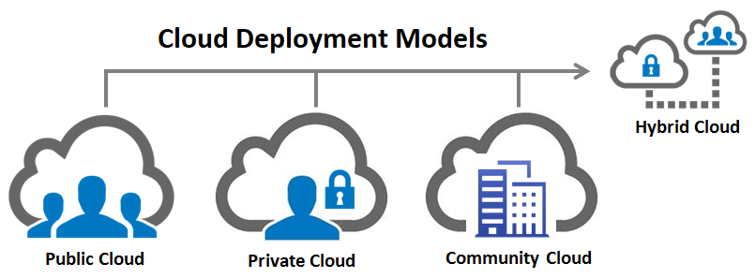
Cloud Deployment Models

Slide 12
Cloud Computing Deployment Models
Cloud deployment models indicate how the cloud services are made available to users. The four deployment models associated with cloud computing are as follows:
Public cloud
As the name suggests, this type of cloud deployment model supports all users who want to make use of a computing resource, such as hardware (OS, CPU, memory, storage) or software (application server, database) on a subscription basis.
Most common uses of public clouds are for application development and testing, non-mission-critical tasks such as file-sharing, and e-mail service.

Slide 13
Private cloud
True to its name, a private cloud is typically infrastructure used by a single organization.
Such infrastructure may be managed by the organization itself to support various user groups, or it could be managed by a service provider that takes care of it either on-site or off-site.
Private clouds are more expensive than public clouds due to the capital expenditure involved in acquiring and maintaining them.
However, private clouds are better able to address the security and privacy concerns of organizations today.

Slide 14
•Hybrid cloud
In a hybrid cloud, an organization makes use of interconnected private and public cloud infrastructure.
Many organizations make use of this model when they need to scale up their IT infrastructure rapidly, such as when leveraging public clouds to supplement the capacity available within a private cloud.
For example, if an online retailer needs more computing resources to run its Web applications during the holiday season it may attain those resources via public clouds.

Slide 15
Community cloud
This deployment model supports multiple organizations sharing computing resources that are part of a community; examples include universities cooperating in certain areas of research, or police departments within a county or state sharing computing resources.
Access to a community cloud environment is typically restricted to the members of the community

